Slide 1
Equipment and Furnishings Task
Intergraph Process Power and Marine

Slide 2
Agenda
Equipment General Overview
Placing Equipment
Placing Equipment Component
Equipment Positioning Relationships
Placing Equipment Shapes
Equipment Nozzle\Ports
Manipulating Equipment
Solid Modeling

Slide 3
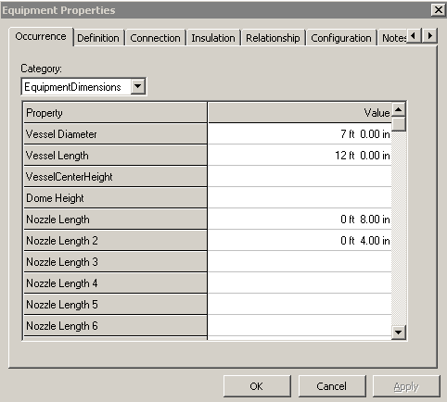
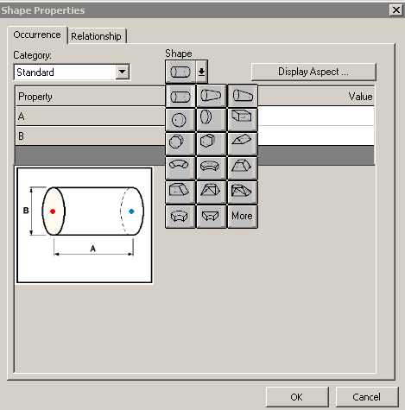
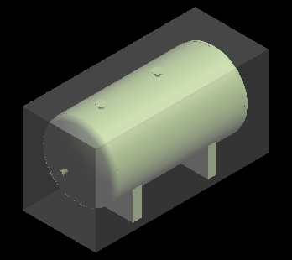
What is SmartPlant/Equipment
SP Equipment is an integrated equipment modeling environment that provides:
- Standard Parametric/Non-parametric Equipment Placement
- Modeling of equipments using primitive shape
Notes:
Select a std equipment from catalog

Slide 4
What is SmartPlant/Equipment
Graphical representation (Symbol Definition) of a Standard Equipment can be created using:
- Visual Basic (Geometry Type Functions)
- 3rd party software – SAT format (Solid Edge v-20)
Aspects: Physical, Insulation, Maintenance, and so on …
Ports available:
      Piping port
      Ducting port
      Cableway port
      Conduit port
      Cable port
      Foundation Port

Slide 5
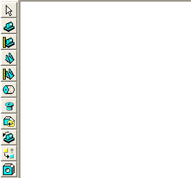











Commands

Slide 6
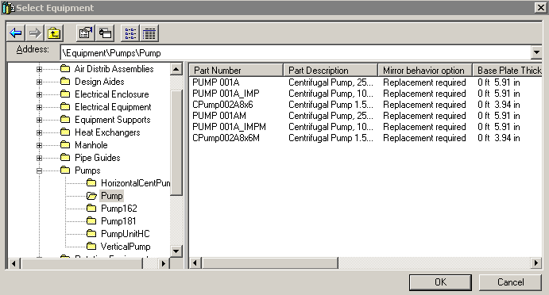
Place Equipment command
The place equipment command activates the Select Equipment dialog box (Catalog Browser) that provides access to standard equipment items that have been defined in the Reference Data.

Slide 7
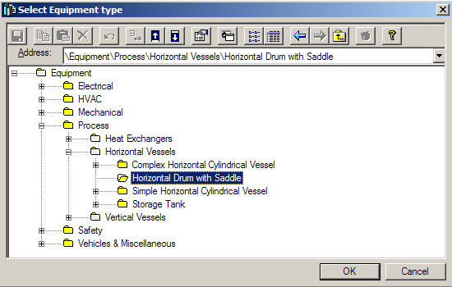
Place Designed Equipment command
The place designed equipment command activates the Select Equipment Type dialog box (Catalog Browser) that provides access to the designed equipment hierarchy

Slide 8
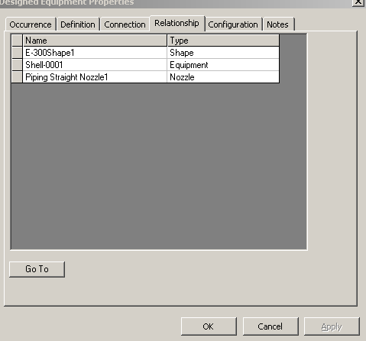
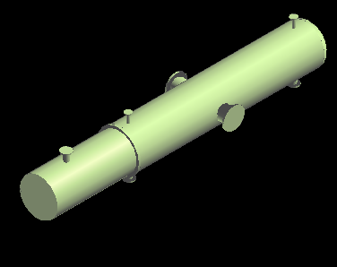
Design Equipment Properties Page
  Display shapes and ports on the relationship tab of the design equipment

Slide 9
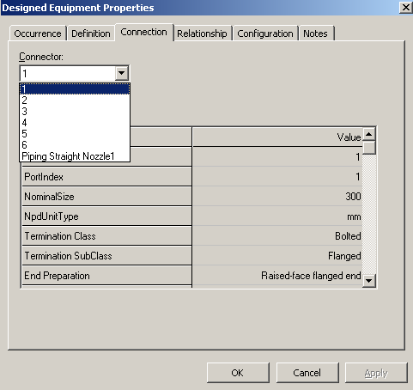
Design Equipment Properties Page
  Display all ports on the connection tab of the design equipment

Slide 10
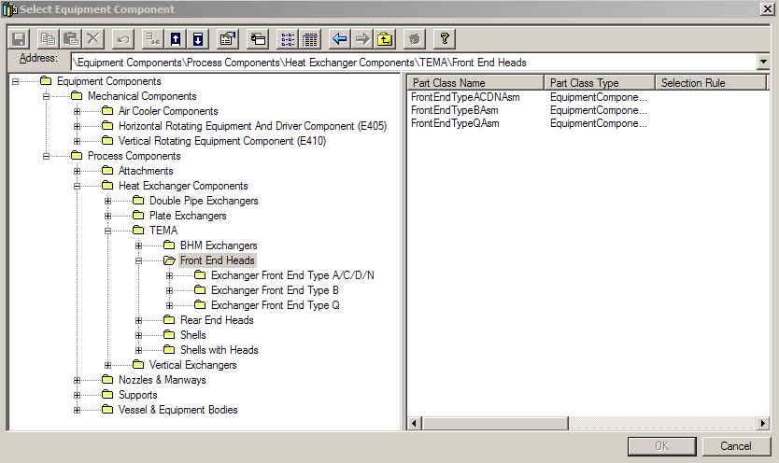
Place Equipment Component command
The place designed equipment command activates the Select Equipment Type dialog box (Catalog Browser) that provides access to the designed equipment hierarchy

Slide 11
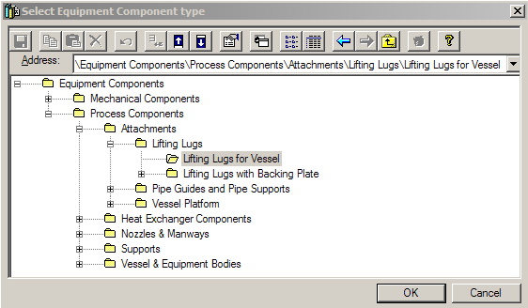
Designed Equipment Component command
The place designed equipment component command activates the Select Equipment Component Type dialog box (Catalog Browser) that provides access to the designed equipment component hierarchy

Slide 12
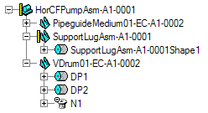
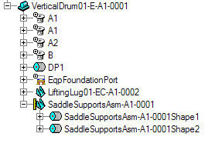
Catalog Equipment vs Designed Equipment
A catalog equipment simply becomes a programmatically defined designed equipment
A catalog equipment can be designed once is placed
Designed Equipment Catalog Equipment

Slide 13
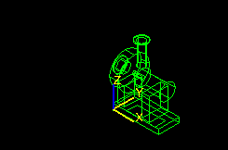
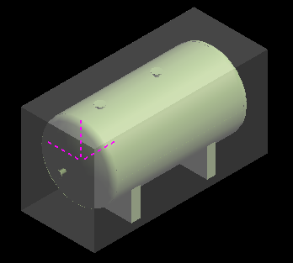
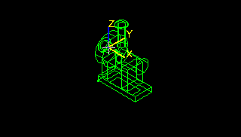
Place Equipment Command
Place Equipment using Symbol Origin by default but if equipment object have datum points associated to then .
origin
origin
Datum Point

Slide 14
Place Equipment SmartSteps ribbon bar
Relationship/Constraints
  Add constraints to further positioning the Equipment.
  Positioning relationships (constraints):
  - Mate
  - Align
  - Connect
  - Minimum Distance (E-W, N-S, Vertical)
  - Parallel
  - Mate to Tangent Plane

Slide 15
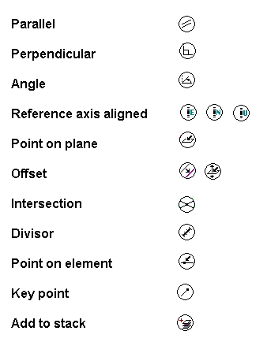
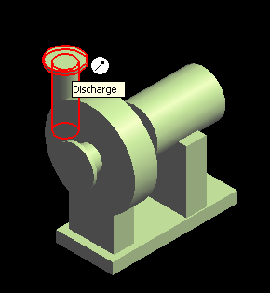
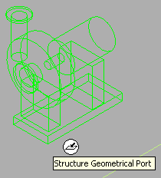
SmartSketch
  SmartSketch is the mechanism to automatically find special points when the command is looking for a point.

Slide 16
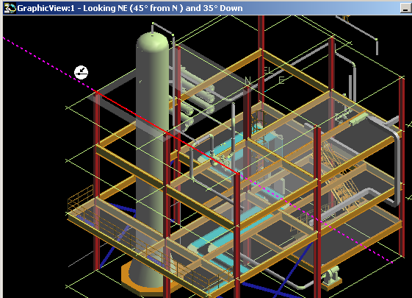
SmartSketch
  The system finds Key point and Point on Geometry whenever you move the cursor over those points.
  System uses only those points (stored in the stack) and check for linear relationship points against every object in the workspace.

Slide 17
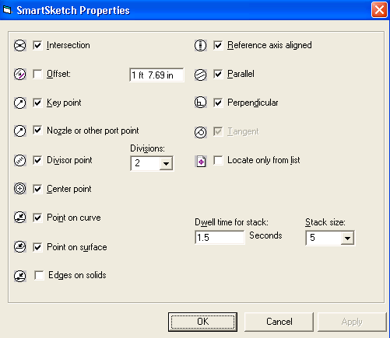
SmartSketch

Slide 18
SmartSketch
User will have two options on what objects are located by SmartSketch.
- Locate on Display List
- Locate on List Only

Slide 19

SmartSketch
SmartSketch Locate List Ribbon Bar
Control –D Keys
Set stack size
Clear stack
Toggle
Display/List only
Set time

Slide 20
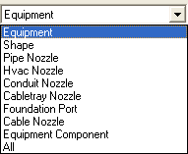
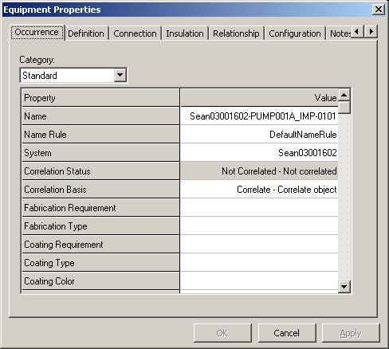
Manipulation Commands
  Equipment Entities Manipulation
  - Select Command
  - Delete Command
  - Undo Command
  - Move Command
  - Rotate Equipment
  - Rotate Command
  - Open the properties page
  - Copy/Paste Command

Slide 21
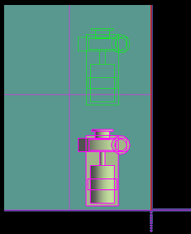
Common Move Smart Step Command
  Define the moving vector.
  The origin of the item is used by default
  as the starting point of the vector.
Move
To
Move
From
Second point
First point

Slide 22
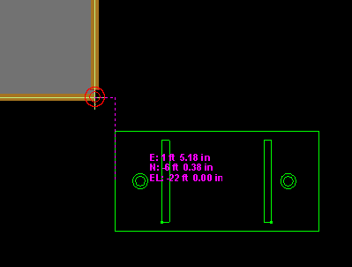
Move Command with PinPoint Tool
PinPoint provides coordinate inputs to the active command.
  - x,y,z coordinates are relative to Target Point.
  - Dynamically displays the coordinate/distance values.
  - Lock the coordinate/distance values.
Target Point

Slide 23
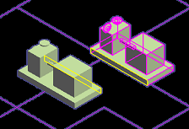
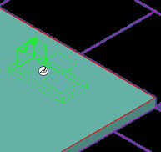
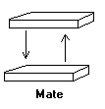
Positioning Relationships
  Mating Relationship
  - Between planar surface and planar surface
  - Surface Normal vectors point to each other.

Slide 24
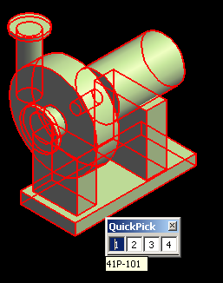
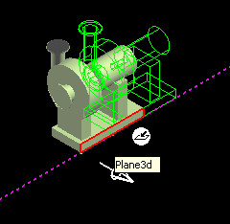
Positioning Relationships
    When the equipment is placed into the active workspace the default surface is automatically constraint to a surface selected in the workspace.
    If the equipment does not have a default surface defined, then the system uses a plane whose normal is along the local coordinate z-axis of the equipment symbol (origin).
    Use Quick Pick toolbar to help you select the surface.
    When highlight surface for relationship, show surface direction vector

Slide 25
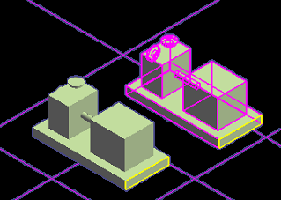
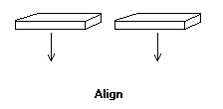
Positioning Relationships
  Align Relationship
  - Between planar surface and planar surface
  - Surface normal vectors point in the same direction.

Slide 26
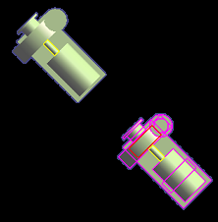
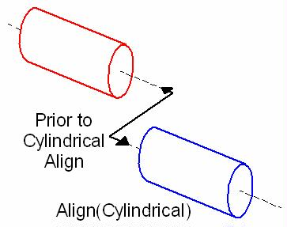
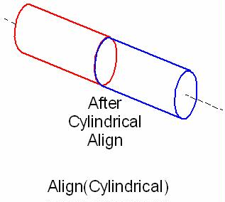
Positioning Relationships
  Mate/Align Relationship
  When you select cylindrical objects, the system uses the axes to create the relationship.
  Make the two axes collinear.
Align relationship

Slide 27
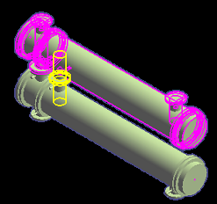
Positioning Relationships
  Connect Relationship
  - forces a port on an equipment to be coincident with a
  port on another equipment.
  - Implicit move command.

Slide 28
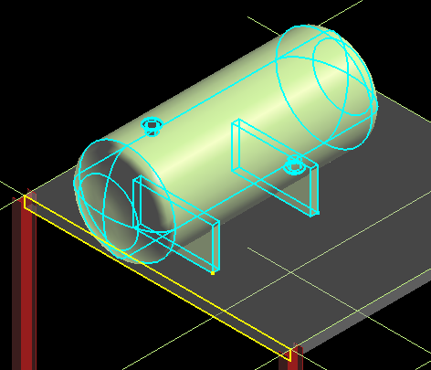
Positioning Relationships
  Minimum Distance (E-W, N-S, Vertical) Relationship
  - Between Point and planar surface (example: 3D plane entities, slabs, etc)
IJPoint
Surface

Slide 29
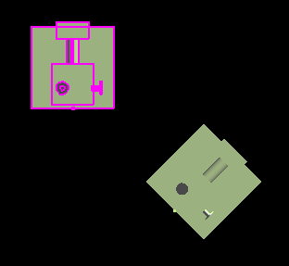
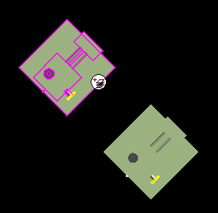
Positioning Relationships
  Parallel Relationship
  - Only Rotate the selected equipment to create the constraint
Surface
Surface
Before
After

Slide 30
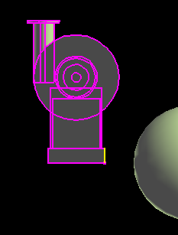
Positioning Relationships
  Mate to Tangent Plane Relationship
  - constraint the equipment oriented to tangent plane to a surface at a given point
Tangent Plane
Vector defined by two pts
Mate Surface
1 ft

Slide 31
Place Equipment SmartStep Ribbon Bar
Set the Positioning Relationship.
Shows the last relationship added in the relationship combo box.
Offset distance
Steps
Positioning Relationship
Delete Relationship

Slide 32
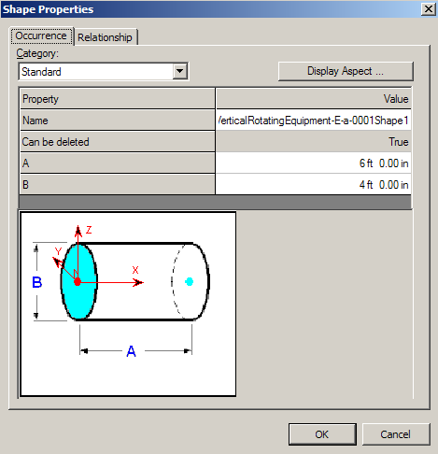

Shapes
Shapes
Customize palette
One-click placement
Activate Shape Reference step
Arrow keys for rotate during placement

Slide 33
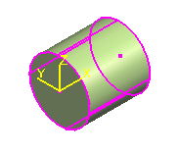
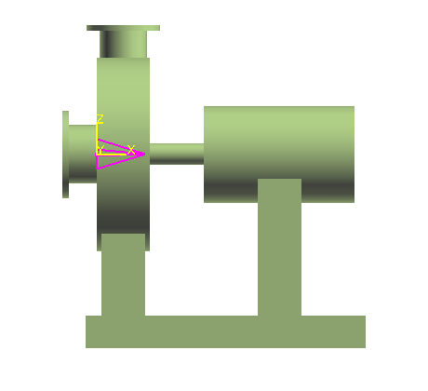
Shapes
Shapes
Place Shape using Symbol Origin by default
Shape (Datum Shape)
Catalog Equipments and Equipments Components come with datum shapes
Datum Point
Origin

Slide 34
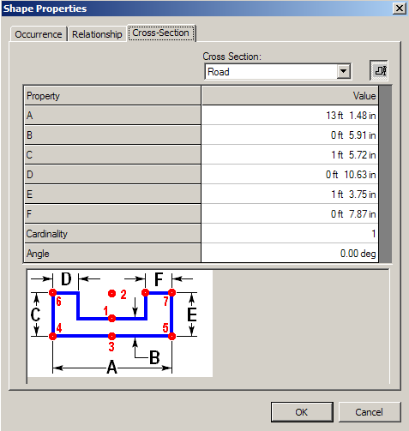
Shapes
Availability of Prismatic Shapes
Prismatic Shape

Slide 35
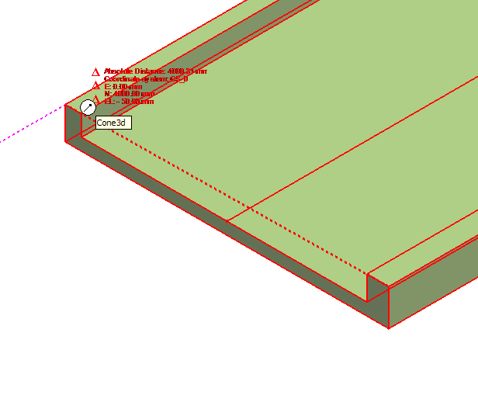
Shapes
All surfaces (persisted) and edges are available on prismatic shapes
Prismatic Shape

Slide 36
Rotate Equipment
Use the Rotate Equipment command
Use the Common Rotate command

Slide 37
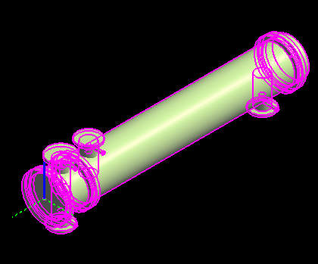
Rotate Equipment
Identify/Change Rotation Axis

Slide 38
Rotate Equipment
  Change the Rotation Point.
  - The rotation point is the first foundation port of the equipment by
  default. If no foundation port exists, the origin of the equipment
  (local coordinate system origin) becomes the default point of
  rotation.
  - If the Equipment is constraint, only one choice is displayed
  (Perpendicular to the constraint plane).

Slide 39
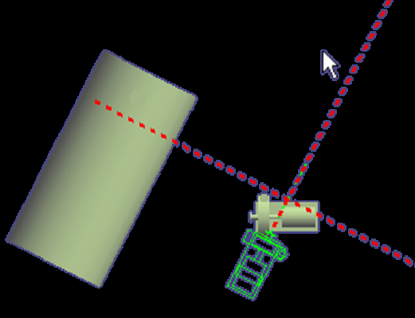
Rotate Equipment
  Ref on Part and Ref on Model steps.
  These steps allow user to define two reference lines by selecting a surface, plane, or nozzle axis and then system calculates the angle between these lines.
plane
Port axis

Slide 40
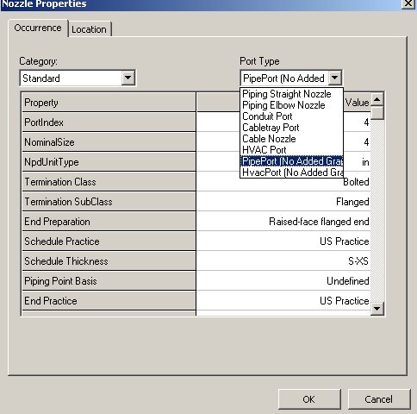
Nozzle Placement Type
  This option allows the user to pick a projection and a plane and key in an offset. The nozzle will then be placed such that the direction is inline with the axis of the projection and the surface is mated with the given offset to the plane selected.
  - Pipe Port (No Added Graphic)
  - Hvac Port (No Added Graphic)

Slide 41
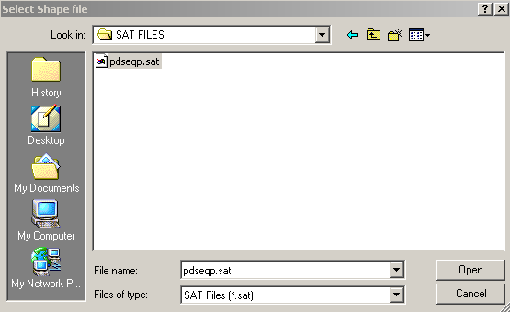
Place Imported Shape from File
This command imports the graphics from a SAT or DGN format file as the geometry for a Designed Equipment shape
  ACIS Output File Format
  The geometry will be converted to G-type format in the model.
  The shape’s origin is defined by the coordinate system of the SAT or DGN file.

Slide 42
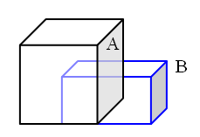


Solid Modeling
Solids will enable the user to use Add, Subtract and Suppress Boolean operations that will assist in creating complex shapes. Designed equipment command should be used to place the designed solid in the model. Multiple designed solids can be placed under single designed equipment. Multiple designed equipments also can be placed under single designed equipment.
  Shape A + Shape B
  Solid Merged Shape
Add Shape
  Shape A - Shape B
  Solid Subtracted Shape
Subtract Shape

